Slide 1

Visualize Me, Captain!
Notes:
Note to presenters
Remember to speak quickly and concisely as we only have ten minutes!

Slide 2
Visualize Me, Captain!
An exploration of Canadian Immigration through data visualizations
Notes:
Introduction
[Everyone should introduce themselves and state their name]

Slide 3
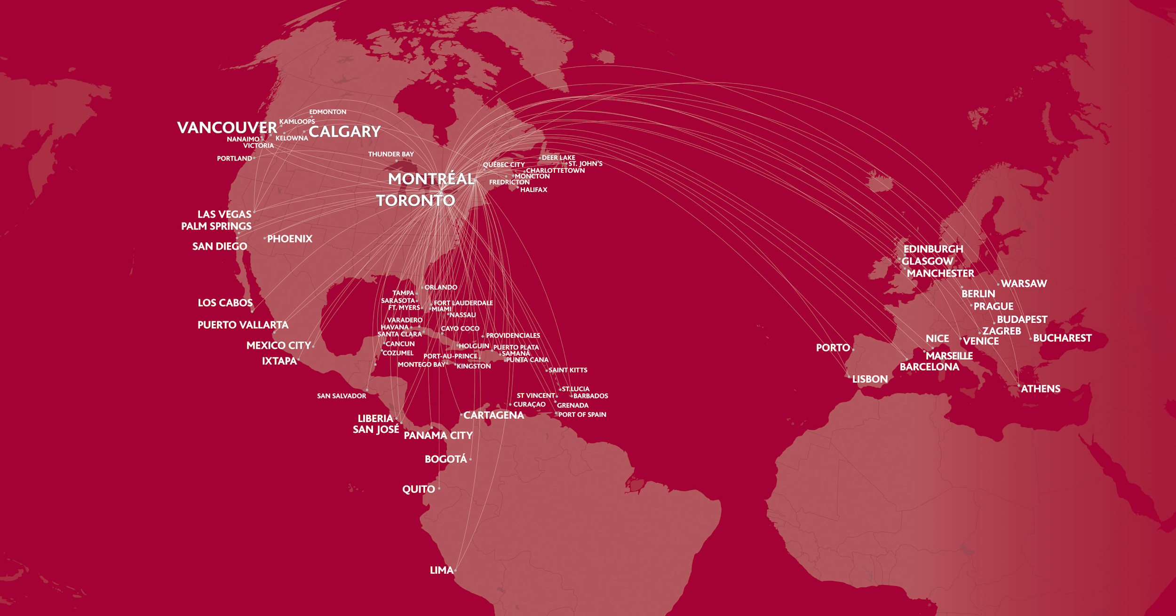
Notes:
Our Theme (1/2)
Canadian immigration is ever-changing, and the areas from which immigration to Canada is prevalent changes every year.

Slide 4

Notes:
Our Theme (2/2)
Today we will present a comprehensive visualization of the different Regions and Countries that Canadian immigrants are coming from (if Conan lets them in).

Slide 5
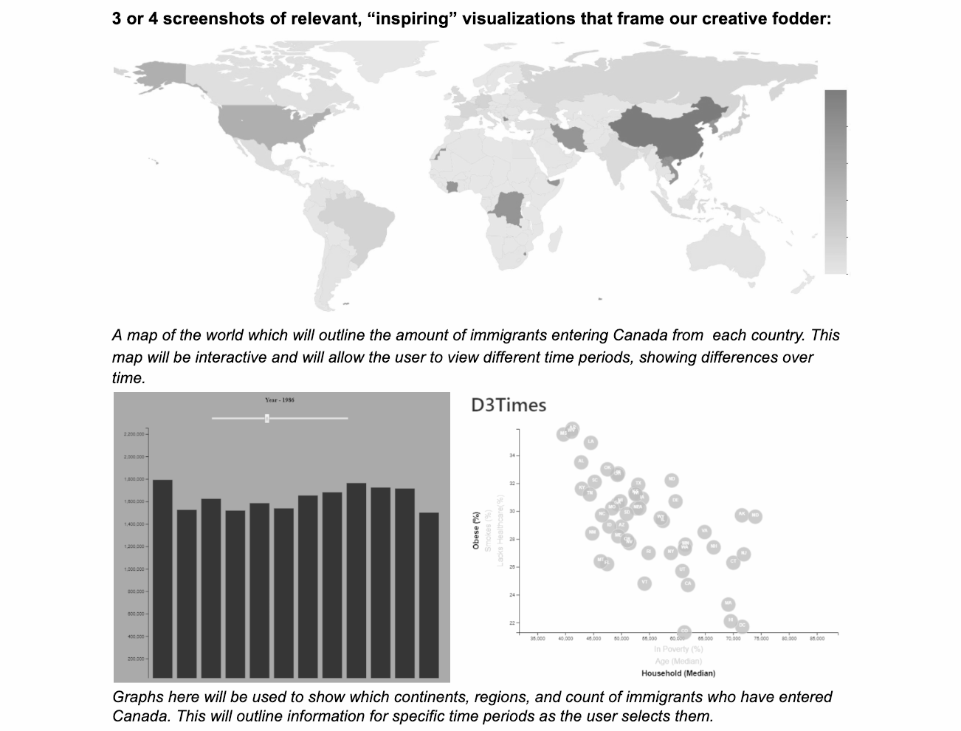
#inspo
Notes:
Our inspiration
Our inspiration included a map of the world which will outline the amount of immigrants entering Canada from each international country
This map will be interactive and would allow the user to view different time periods, showing differences over time
We also used graphs to show which continent and regions originate which count of immigrants entering Canada
This would outline information for specific time periods as the user selected them

Slide 6

Our techniques
Notes:
Our data munging techniques
Our data sources:
Dataset from [website]
REST Countries API
Our data preparation:
Converted into CSV format & grouped into pandas
Used REST Countries API to gain additional information about the countries

Slide 7
Our coding approach
Notes:
Our coding approach
Used python to code our visualization into existence
Used Heroku to host our visualization online

Slide 8
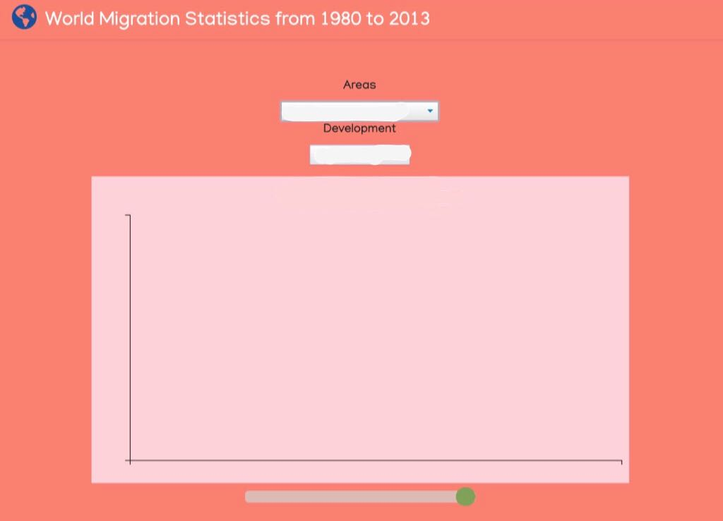
Our final visualization
☝️ this
is here if we need it
Notes:
Our final visualization
[notes to cover while presenting]
Embed page into Slides: https://support.google.com/docs/thread/6666929?hl=en

Slide 9
The pros
Notes:
Pros
As the project outline specified, we definitely thought broadly as this data covers the entire world
Our three views in these visualizations provide visibility into all immigrants’ country of origin
The interactive visualization provides details about country, region, sub-region, and development status of each area to go into more detail than just “Where are immigrants coming from”

Slide 10
The cons
Notes:
Cons
Likely would have had more interactive elements if we had more time to work on this project
The data shown in our visualization does not include statistics on who is emigrating from Canada and when, and we are therefore unable to give an accurate total of how many immigrants are currently in Canada based on this visualization only
Unable to see further information on why immigrants are leaving their current home and why they chose Canada as a destination
Visualizations provide an interactive surface-level outline of data points but do not allow you to do a deep dive on the information you are viewing

Slide 11
Let’s reflect...
Notes:
Reflection
Our visualization could be used to present key facts and figures about Canada’s immigration trends for the past 30+ years
This data would be useful to determine ways in which to anticipate future immigration trends and adjust policy and restrictions accordingly
This visualization is helpful because it is a quick and interactive way to review this data ensuring clear communication of the facts and accurate reporting on an important issue, which can help improve it for future generations.

Slide 12
If this:
...is you, now
is your time.
Notes:
[hold for questions]

Slide 13
Thank you
Notes:
[hold for applause]

